Slide 1
Master these 6 types of plots you can make 90% of the figures
Ming Tommy Tang
Divingintogeneticsandgenomics.com
Youtube: chatomics

Slide 2
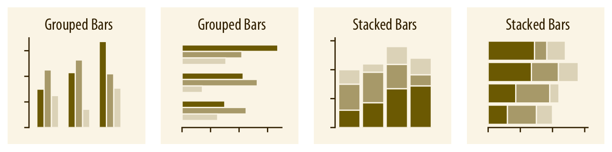
Barplot
https://clauswilke.com/dataviz/directory-of-visualizations.html

Slide 3
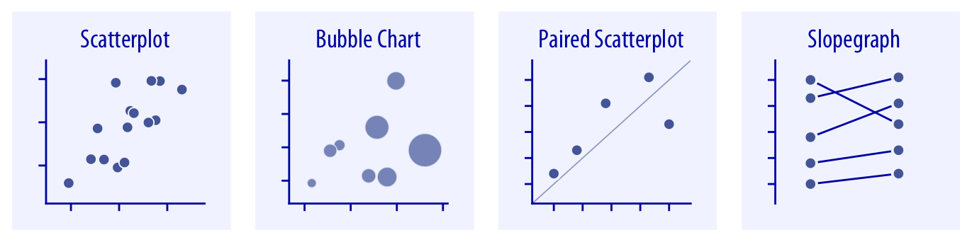
Scatter plot
https://clauswilke.com/dataviz/directory-of-visualizations.html

Slide 4
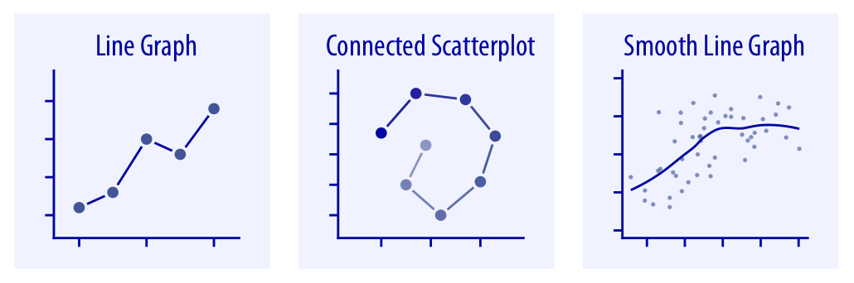
Line graph

Slide 5
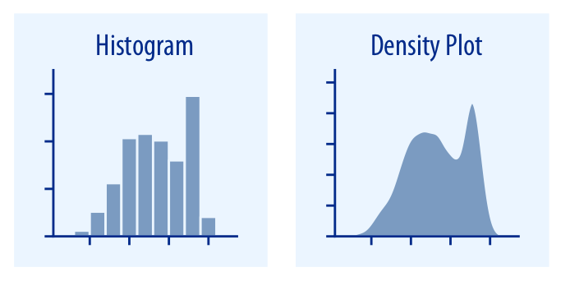
Histogram

Slide 6
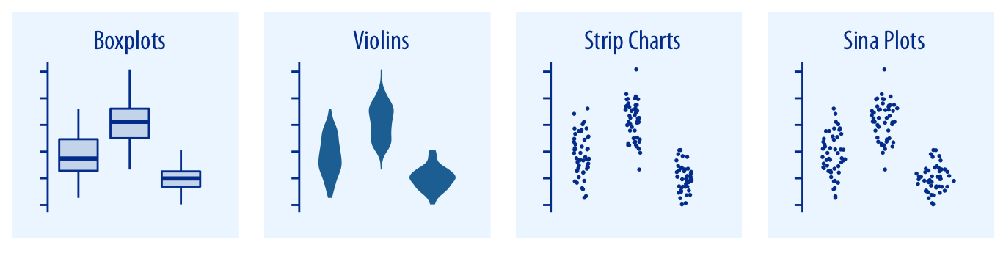
Boxplot /violin plot
ggplot2: https://github.com/rstudio/cheatsheets/blob/main/data-visualization.pdf

Slide 7
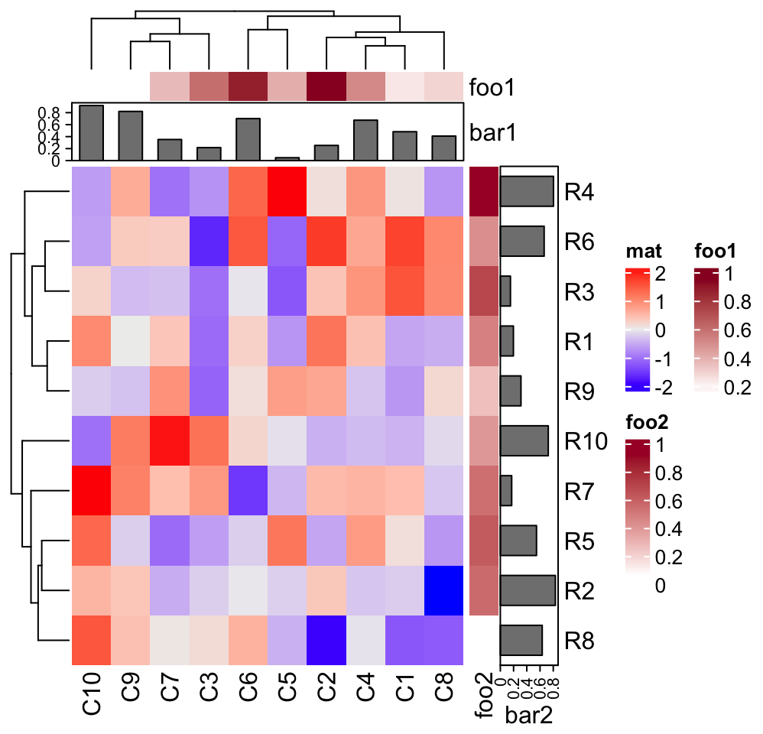
Heatmap
https://jokergoo.github.io/ComplexHeatmap-reference/book/heatmap-annotations.html

Slide 8
Click subscribe if you liked this content! Thank you.
Happy Learning!
Tommy

